Slide 1
NUMBER PLATE DETECTION AND RECOGNITION IN PYTHON
Submitted by:
Student Name University Roll No.
SAHIL SINGH RANA 2019582
Under the Mentorship of
Ms. Meenakshi Maindola
Assistant Professor

Slide 2
INTRODUCTION
The interface in system is an interactive number plate detection using python.
This application is designed to extract characters from plates and identify the corresponding state information.
This application is used in traffic monitoring, security surveillance and parking management.

Slide 3
PROBLEM STATEMENT
Develop an efficient and user-friendly Number Plate Detection and Recognition system.
The system should allow user to capture image through camera and upload images using graphical interface.

Slide 4
LIBRARIES USED
tkinter
os
cv2
numpy
pytesseract

Slide 5
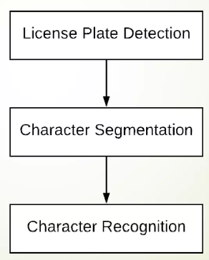
STEPS INVOLVED

Slide 6
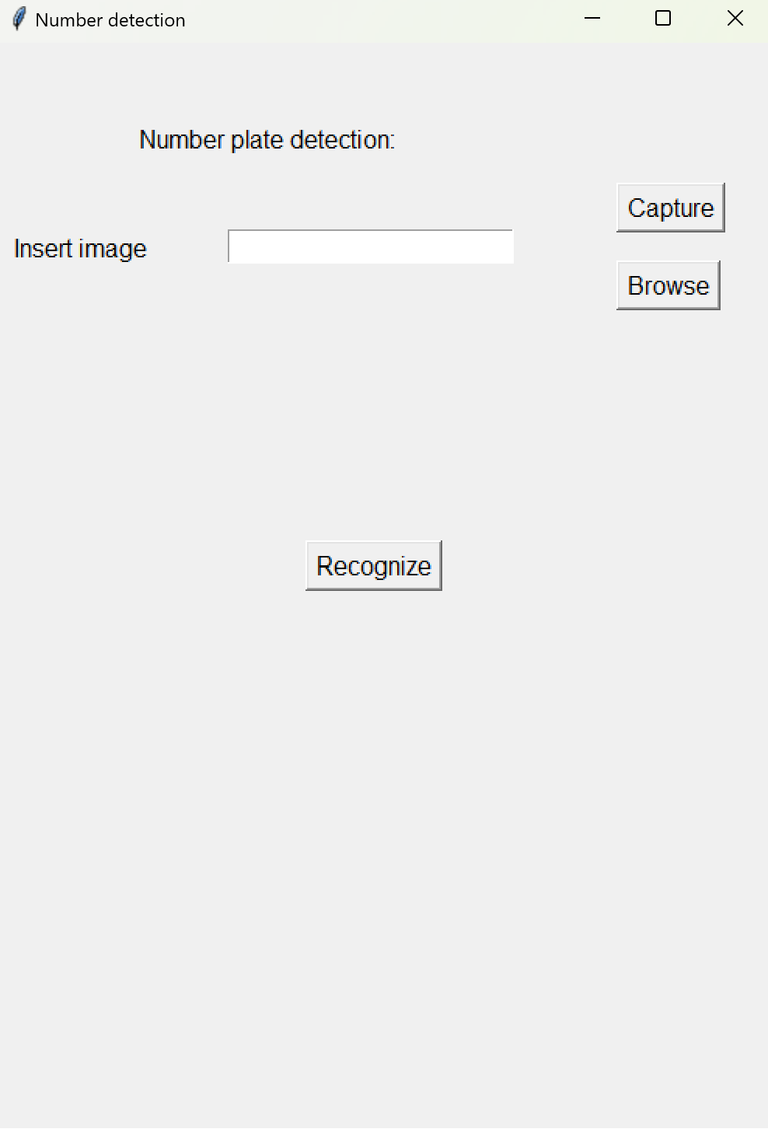
METHODOLOGY
User Interface and Image Input

Slide 7
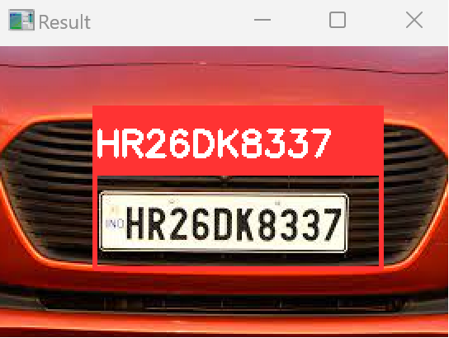
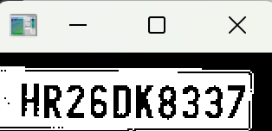
METHODS
Image Capture and Preprocessing
Text Extraction

Slide 8
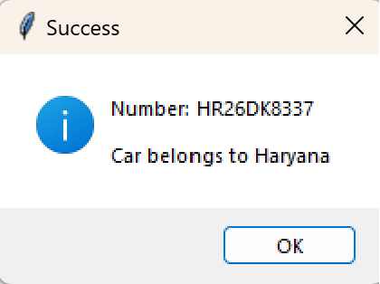
RESULT
Success
Showcase the extracted number plate text along with additional details such as the recognized state name, if available.

Slide 9
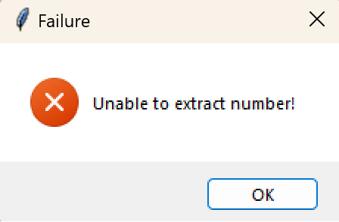
Failure
Implement mechanisms to handle failures, display appropriate error messages for unrecognized plates or processing errors.

Slide 10
CONCLUSION
The project successfully showcases the extracted number plate text, providing additional details such as the recognized state name if available.
The error handling mechanisms have been implemented to manage failures and display appropriate error messages in cases of unrecognized plates or processing errors.

Slide 11
APPLICATION
Mobile Application Development
Expansion of Recognition Capabilities
Real-time Processing Optimization

Slide 12
THANKYOU

